Slide 1

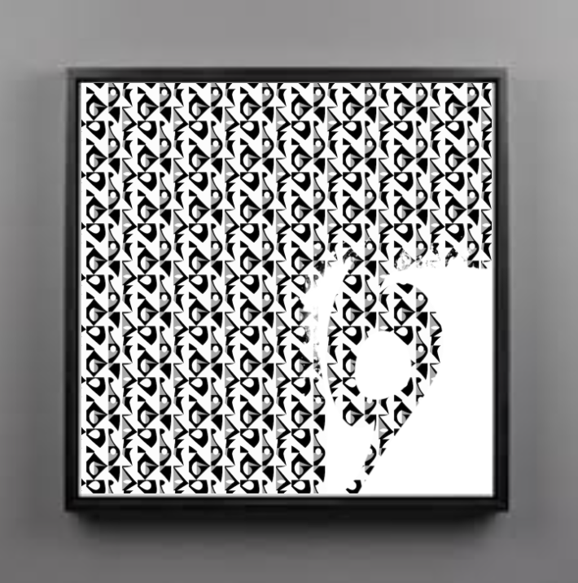
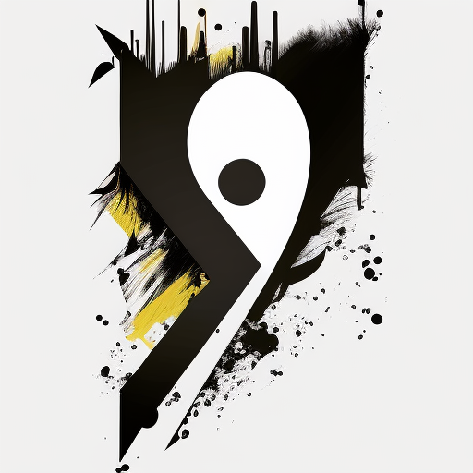
Crafting Arabic Calligraphy in the Digital and AI Era
Upload image in midjourney
by Dr. James

Slide 2
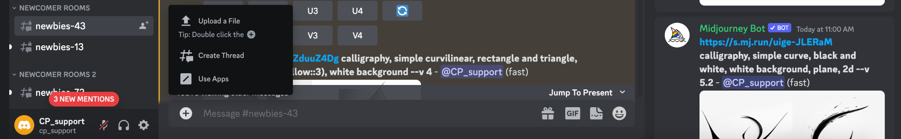
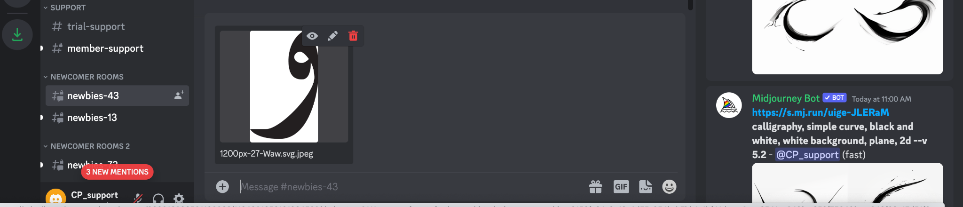
2.
1.
3. “Press enter”

Slide 3
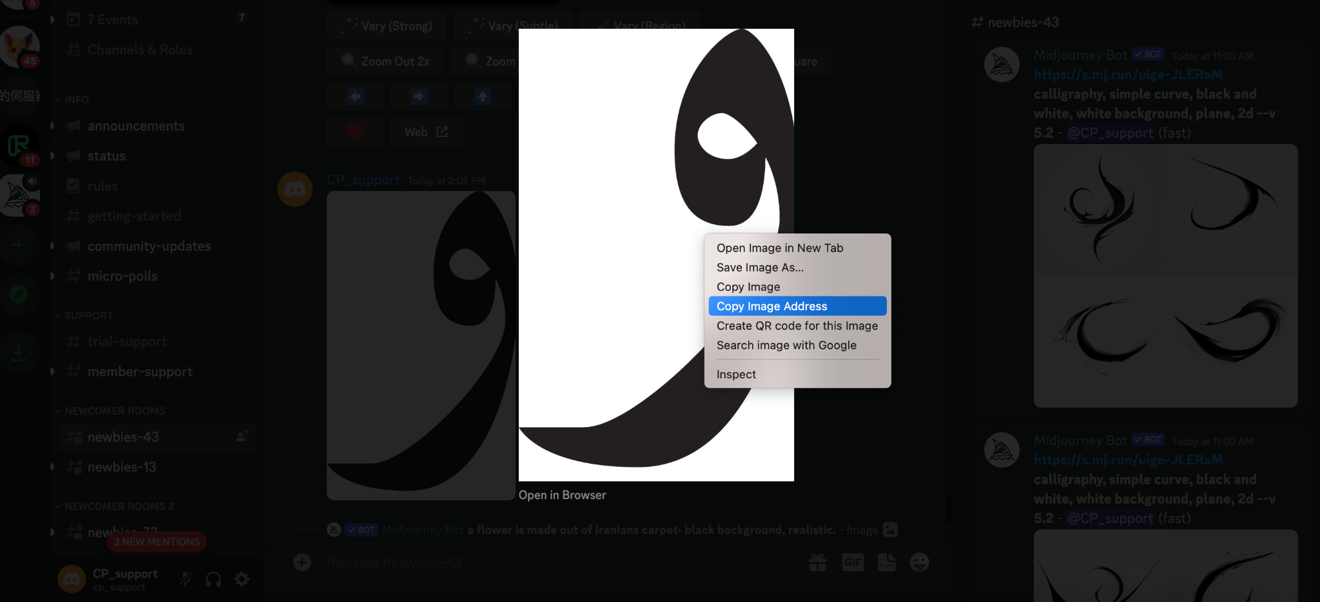
4. Right click and select to copy the image link
Image Link Example:
https://media.discordapp.net/attachments/990816806581198869/1164081868040314930/1200px-27-Waw.svg.jpeg?ex=6541eab8&is=652f75b8&hm=cc69dfdd5471f204554059da931355aff116abc486a8f767b7cd7e9d75098587&=&width=622&height=1024

